Slide 1

Predicting Heart Disease with Classification
This project predicts heart disease using machine learning. It analyzes health data to identify risk patterns. Early detection aids timely treatment and preventive care. Our system provides faster, more reliable medical insights.
PRESENTED BY AYESHA IMRAN (2023-BSAI-011)

Slide 2

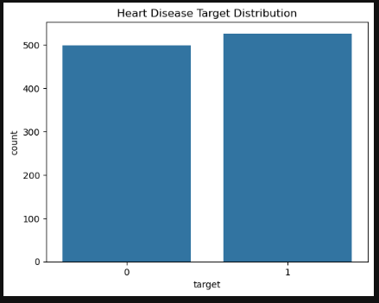
Dataset Overview
Dataset Name
Heart Disease Classification Dataset
Individuals
1024 records
Key Features
Age, Sex, Chest Pain Type, Blood Pressure, Cholesterol, Heart Rate, Angina, ST Depression, Oldpeak, Slope, Major Vessels
Target Column
1 = Heart Disease, 0 = No Heart Disease
The dataset contains 1024 individual health records. It includes 14 features for heart disease classification. These features cover various medical measurements. The target column indicates presence or absence of heart disease.

Slide 3
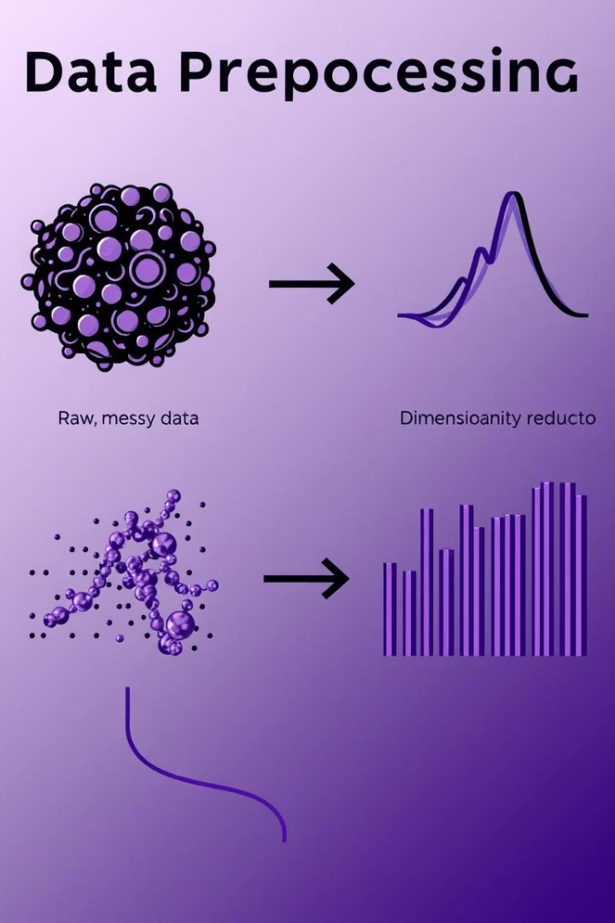
Preprocessing Steps
1
Data Cleaning
Checked for missing or incorrect values.
2
removing dublicates
removing redundancy
3
Feature Scaling
Applied StandardScaler to normalize numeric values.
4
outlier detection
removing outliers

Slide 4
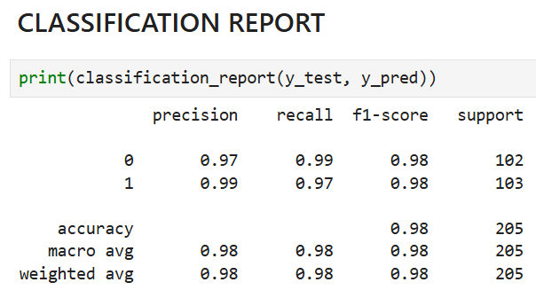
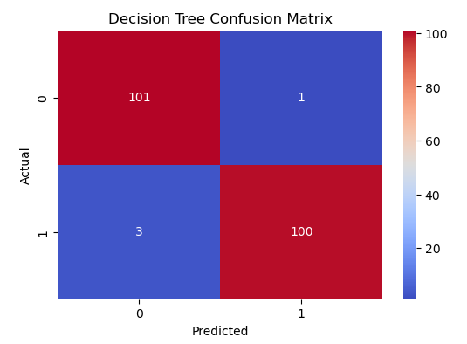
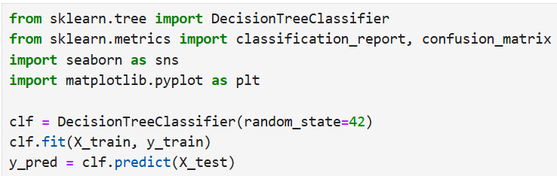
Models Used
DECISION TREE
A tree-like structure for clear decision-making. Simple to interpret.
CODE

Slide 5
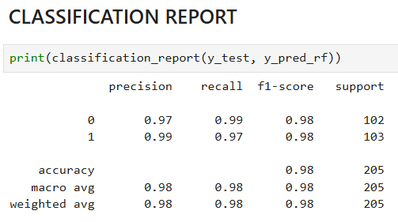
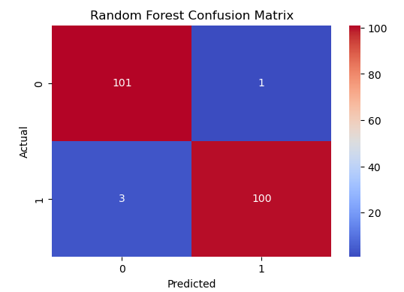
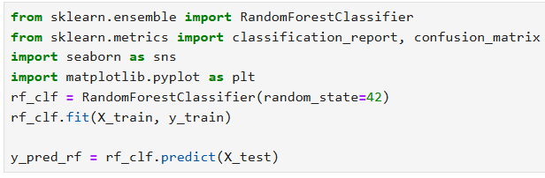
Models Used
Random Forest
Combines multiple decision trees for robust accuracy. Reduces overfitting.
CODE

Slide 6
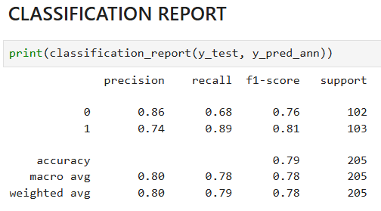
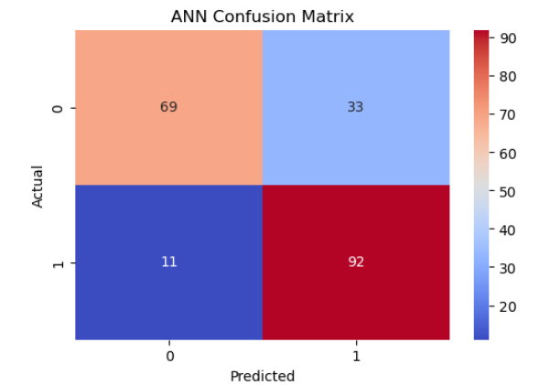
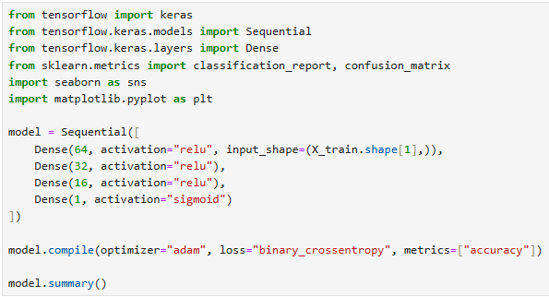
Models Used
Artificial Neural Network
Inspired by the human brain, detects complex patterns. Achieves high performance.
CODE

Slide 7
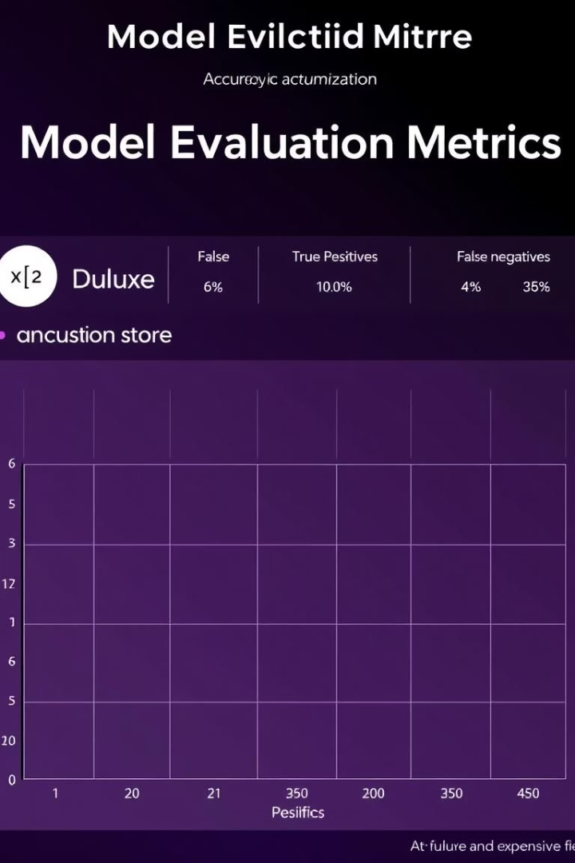



Evaluation Methods
Accuracy Score
Confusion Matrix
Model Comparison
Measures overall correct predictions. Primary performance metric.
Visualizes correct and incorrect classifications. Provides detailed insight.
Compares all models. Identifies the most reliable. Ensures optimal choice.
Model performance was evaluated using accuracy score. A confusion matrix detailed prediction outcomes. All models were compared to identify the most reliable performer. This ensures robust and trustworthy results.

Slide 8
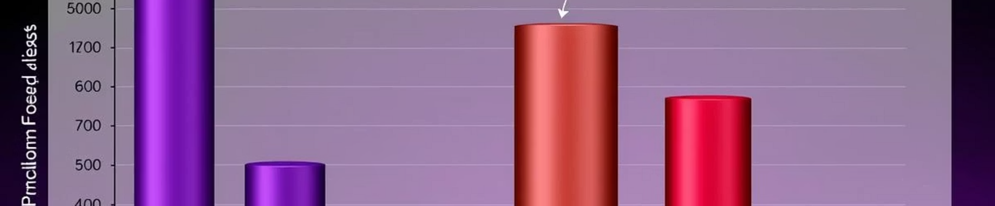
Key Findings
Top Performance
Preprocessing Impact
Accurate Predictions
Random Forest and ANN achieved highest accuracy.
Data balancing and scaling improved models.
Models reliably predict heart disease.
Random Forest and ANN demonstrated superior accuracy. Preprocessing steps, including balancing and scaling, significantly boosted performance. The final models provided accurate heart disease predictions, validating our methodology. This confirms their utility in clinical settings.

Slide 9

Conclusion
Reliable Prediction System
Successfully developed an accurate heart disease predictor.
Trustworthy Models
Machine learning models provided fast, dependable results.
Enhanced Healthcare
Aids early detection and improves medical decisions.
This project established a robust heart disease prediction system. Our machine learning models offer reliable and swift predictions. This system is poised to enhance healthcare by enabling earlier risk detection and supporting informed decision-making for doctors and patients.

